Slide 1

Amazon Sales Data Analysis
Done By - Akash Krithik
Mentor - Ashish Rajput
Date - 07-04-2025

Slide 2
Introduction
Project Objective
Analyze Amazon sales data to understand customer behavior, product performance, and revenue trends.
Leverage data insights to improve marketing, pricing, and growth strategies using Python tools.
Scope
Clean and preprocess sales data
Segment customers (KMeans)
Analyze trends and revenue patterns
Visualize key metrics and behaviors
Support strategic decisions in pricing, marketing, and inventory

Slide 3
Focus Areas Overview
The presentation will explore the following key focus areas:
Sales Performance Analysis
Pricing Strategy Evaluation
Customer Demographics and Behavior
Product Category Trends
Seasonal Sales Analysis
Seller Performance Analysis
Marketing and Advertising Effectiveness
Customer Reviews and Ratings Impact
Inventory and Supply Chain Management
Competitor Analysis

Slide 4
Business Objectives
Identify high-value customers and their buying behavior
Group customers for targeted marketing
Uncover pricing, discount, and revenue trends
Evaluate product performance to optimize pricing and stock
Enable data-driven strategies for customer engagement and profitability

Slide 5


Sales Performance Analysis
Interpretation:
Smartphones and Smart Televisions dominate revenue, highlighting them as the most profitable product categories.
Interpretation:
Sales volume appears unaffected by price, indicating consistent demand across price ranges.

Slide 6

Sales Performance Analysis (contd)
Central Limit Theorem (CLT)
Key Takeaways:
Sample means are roughly normal despite skewed data.
Most fall between 2,000–4,000; slight right skew from outliers.
Larger samples (n=30
Why It Matters:
Aids revenue prediction and sales trend analysis.
Strengthens

Slide 7
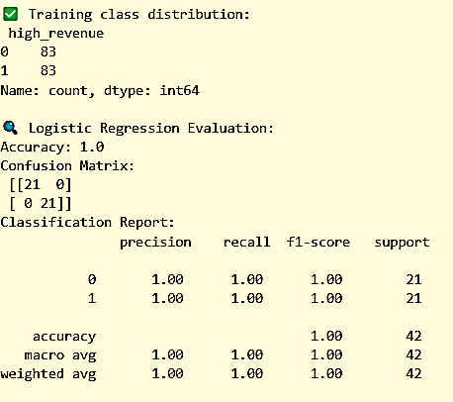
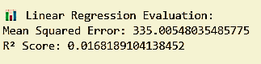
Pricing Strategy Evaluation
Leveraging Machine Learning for Revenue Prediction and Customer Identification.
Attempted to predict log(revenue) using various product features.
Perfect Accuracy (Balanced Test Set):
Model predicts high-revenue status very well when data is balanced.
Aimed to classify customers as "high-revenue" or not.
Low R-squared (~0.017):
Features show weak linear correlation with revenue.

Slide 8
4 clusters show spending diversity:
Blue: High spenders
Yellow/Green: Prefer low-price items
The model underpredicts high revenues, showing poor fit—suggesting non-linear patterns or missing features.
Pricing Strategy Evaluation (contd)
Customer Segmentation & Limited Revenue Prediction

Slide 9

Interpretation:
Elbow plot suggests 3 optimal clusters, reflecting distinct customer spending patterns.
Customer Demographics and Behavior

Slide 10
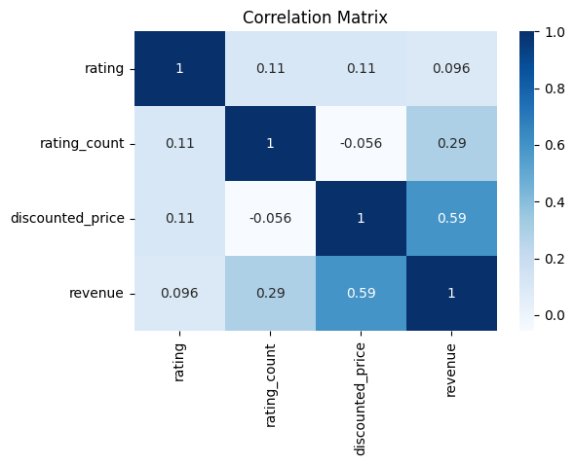
Product Category Trends
Key Observations:
Weak Correlation with Rating:
Slight Negative Correlation:
Strong Positive Correlation: ‘Discounted Price’ (0.59) and ‘Rating Count’ (0.29) positively impact revenue, with price having a stronger influence
‘Rating’ has a weak positive correlation with ‘Rating Count’ (0.11), ‘Discounted Price’ (0.11), and ‘Revenue’ (0.10).
‘Rating Count’ and ‘Discounted Price’ show a weak negative correlation (-0.06).
Interpretation:
Price strongly affects revenue. Ratings have a minor impact, with only a moderate link to revenue and little effect on price.

Slide 11
Product Category Trends (contd)
Hypothesis Testing: Rating and Revenue Impact
Revenue vs. Rating Groups
Method: T-test between High-rated (≥4) and Low-rated (<4) products
Result:
T-statistic: 16.62
P-value: 0.0000
Conclusion:
Significant difference in revenue between high and low-rated products
Rating Count vs. Revenue Correlation
Method: Pearson correlation with significance test
Result:
Correlation: 0.2941
P-value: 0.0000
Conclusion:
Significant positive correlation between rating count and revenue
Interpretation:
Higher-rated products earn significantly more revenue
More ratings = higher revenue
Customer feedback volume plays a key role in product success

Slide 12

Key Insight:
Smart gadgets lead revenue; focus on top categories like Smartphones and SmartWatches for growth.
Top Products Insight:
Top 3 drive most revenue; B09GFPVD9Y leads. Prioritize high performers for better ROI.
Seasonal Sales Analysis

Slide 13
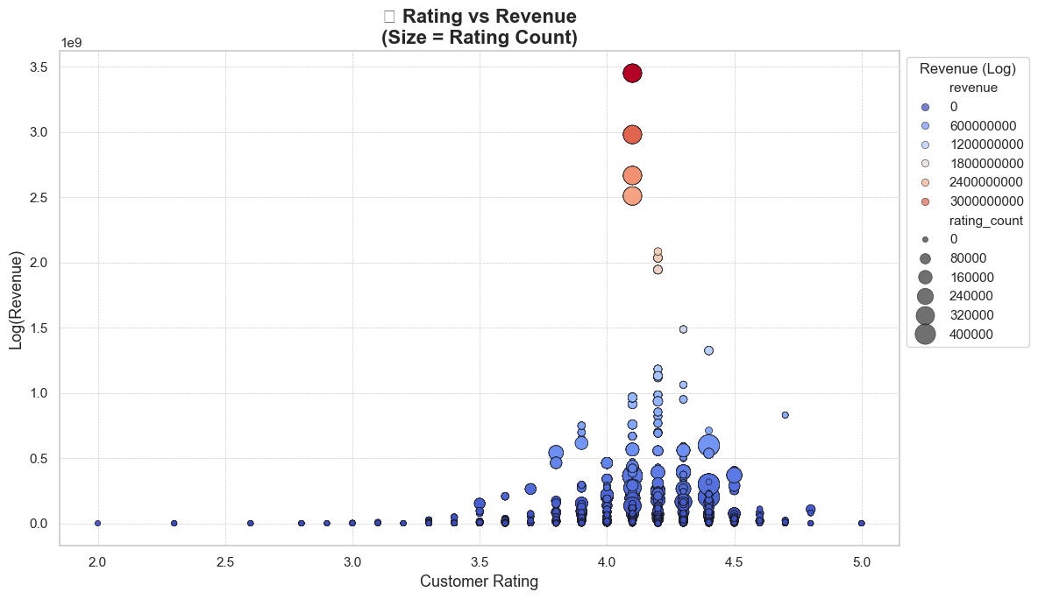
Seasonal Sales Analysis (contd)
Interpretation:
High revenue is driven by products with ratings between 4.1–4.3 and a large number of reviews, while low-rated products (below 3.5) rarely perform well.

Slide 14
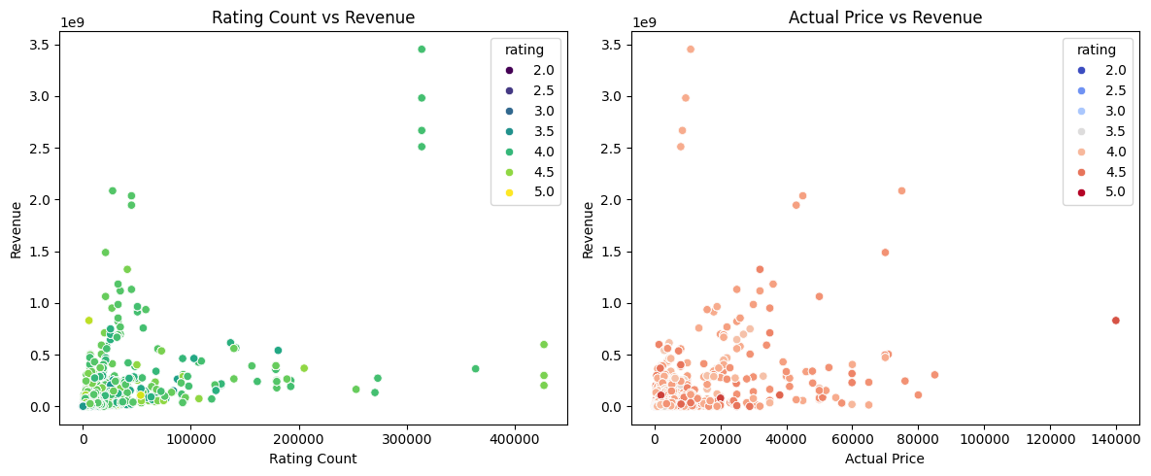
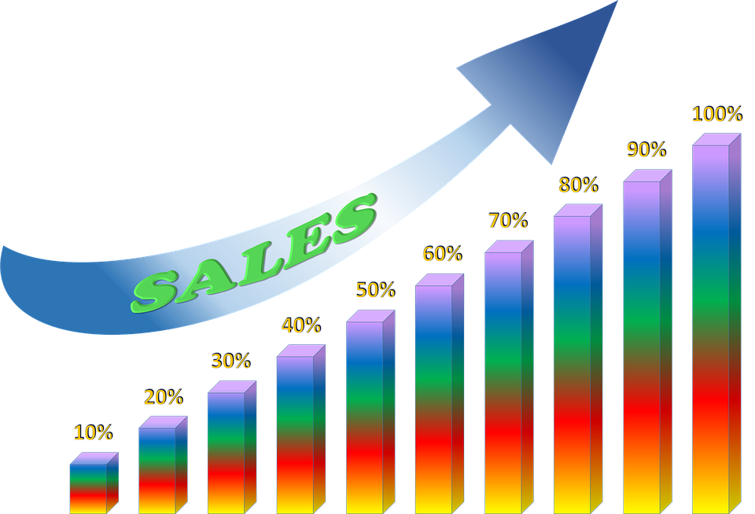
Seller Performance Analysis
Interpretation:
Products with more ratings tend to earn more, highlighting that popularity strongly correlates with higher revenue.
Interpretation:
High revenue is mostly driven by moderately priced products (₹0–₹40K), not necessarily the most expensive ones.

Slide 15

Interpretation:
The 21–30% discount range drives the highest revenue. Steep discounts (61%+) also perform well, likely from volume sales, while minimal discounts (0–10%) attract the least customer interest.
Interpretation:
Discounts have little to no effect on the number of ratings a product gets, indicating weak influence on customer feedback volume.
4o
Marketing and Advertising Effectiveness

Slide 16
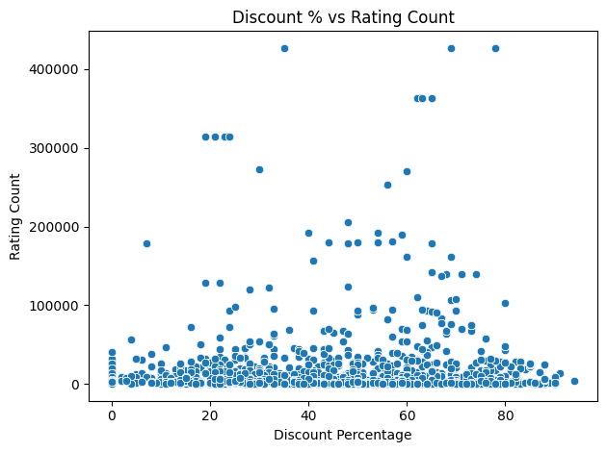

Marketing and Advertising Effectiveness (Contd)
Interpretation:
Rating counts remain low across all discount levels, showing no consistent pattern—high discounts don't guarantee more ratings.

Slide 17
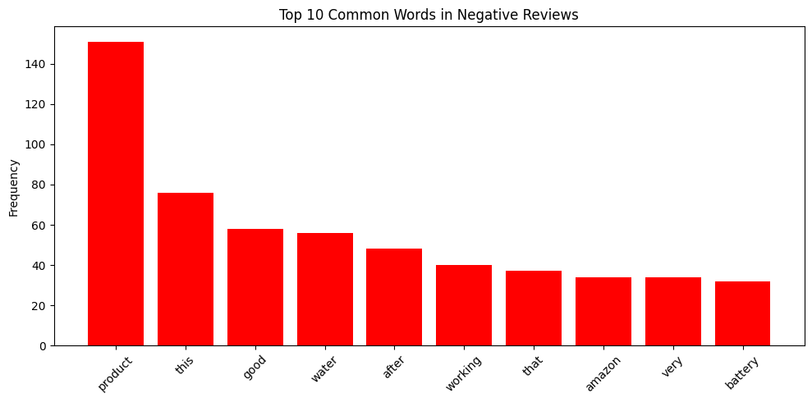

Customer Reviews and Ratings Impact
Interpretation:
Frequent negative reviews focus on product issues (like water resistance or battery), platform concerns (Amazon), and vague dissatisfaction (“this,” “that”)—highlighting quality and service problems.

Slide 18
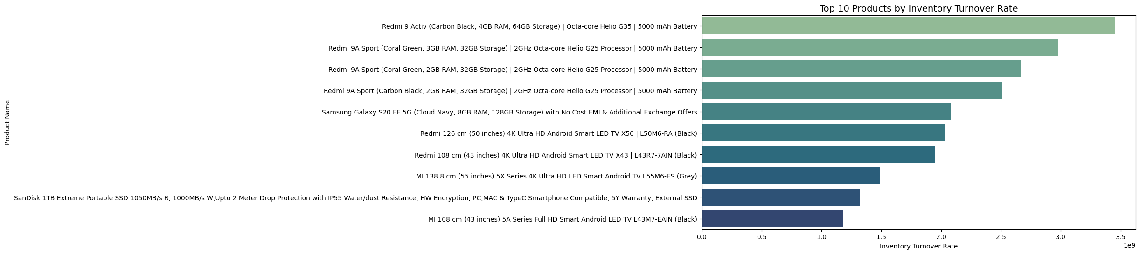
Inventory and Supply Chain Management
Interpretation:
Smartphones like Redmi 9 series and Samsung Galaxy S20 FE 5G show the fastest inventory turnover, indicating high demand. Smart TVs also perform steadily, while the SanDisk SSD lags with slower stock movement.

Slide 19
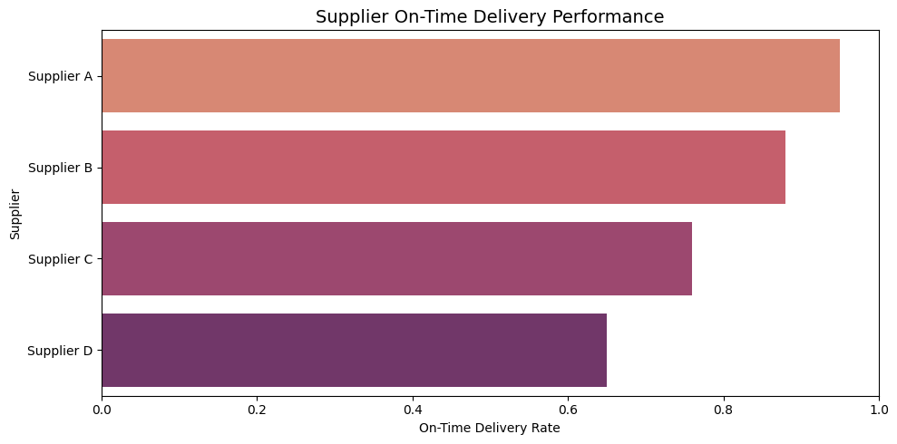
Inventory and Supply Chain Management (Contd)
Interpretation:
Supplier A leads in on-time delivery, followed closely by B. Supplier C lags behind, and Supplier D performs the worst with the lowest delivery reliability.

Slide 20
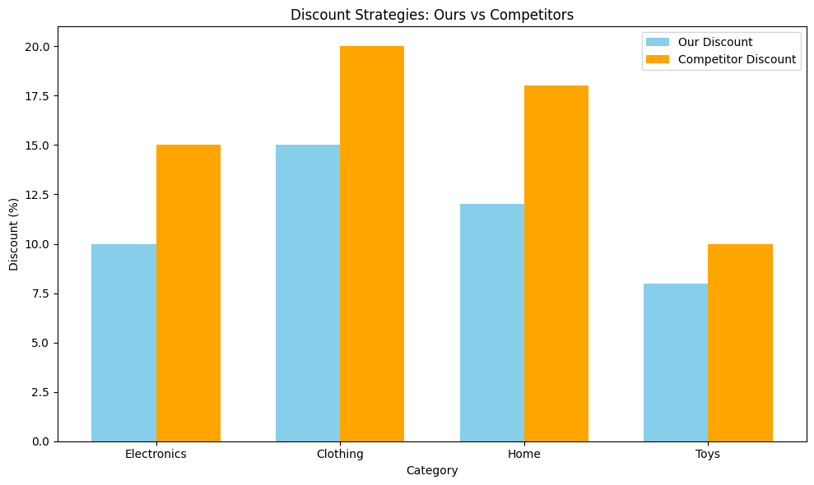
Competitor Analysis
We're offering lower discounts across all categories, which may reduce competitiveness against rival pricing strategies.

Slide 21

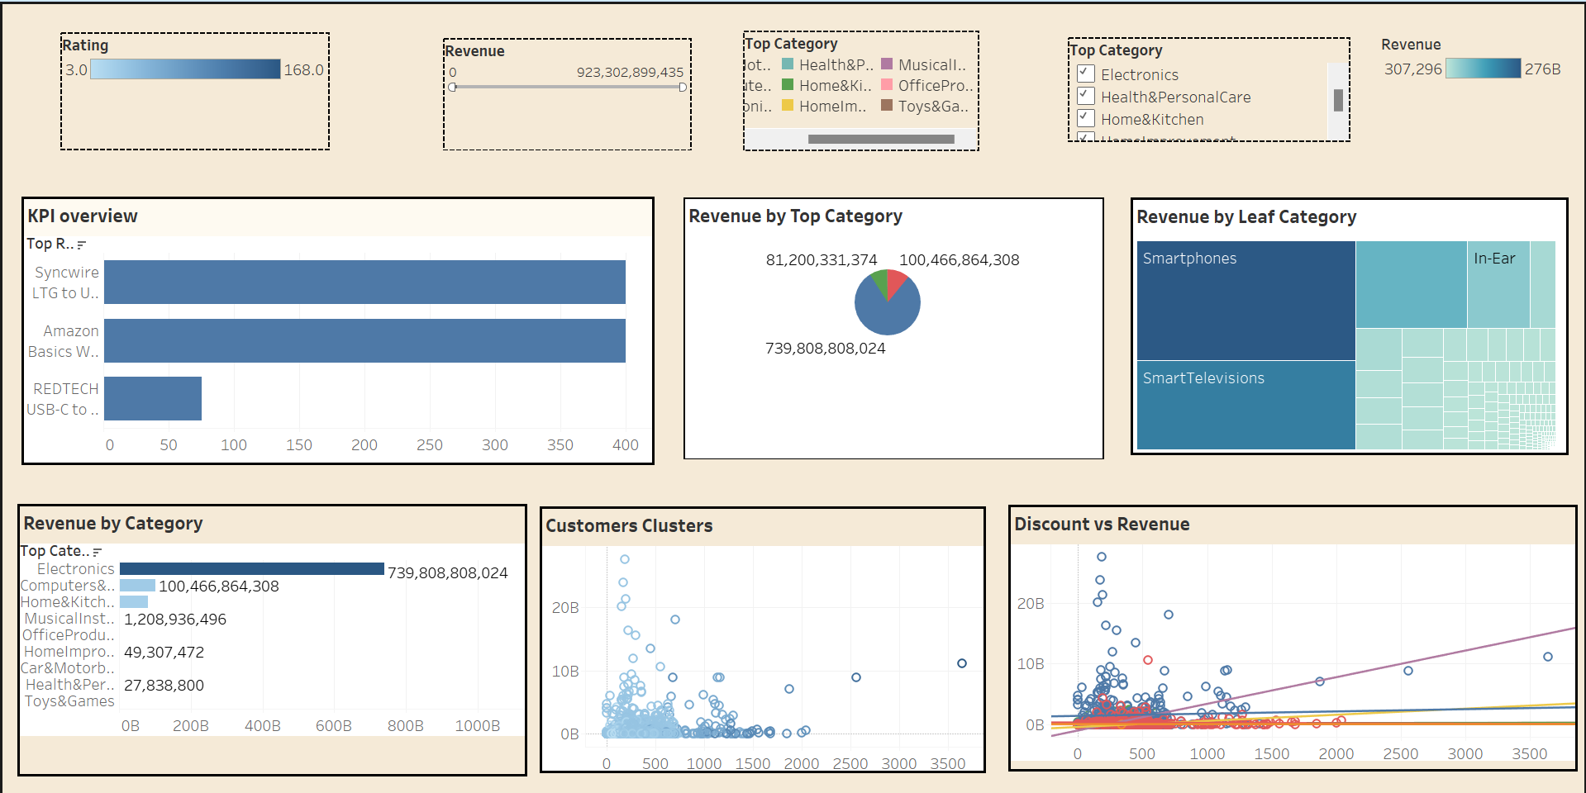

Amazon Sales Inteligence Data
Sales Revenue
276B
KPI
178K

Slide 22
Summary
🔹 Overall Interpretation
Throughout our multi-phase analysis of Amazon sales data, we uncovered key insights on customer behavior, product performance, and operational strategies.
These findings support data-driven decision-making for growth, customer retention, and market competitiveness.

Slide 23
Conclusion
Smartphones and Smart TVs are the top revenue generators.
Customers fall into three main spending segments, with high spenders spread across all price points.
Discounts between 21–30% are most effective; minimal discounts lead to low sales.
Higher-rated products and those with more reviews generate significantly more revenue.
Customer feedback volume matters more than rating scores.
Logistic regression helps identify high-revenue customers; linear models struggle with revenue prediction.
Inventory turnover is highest for popular smartphones and TVs.
Supplier A leads in delivery performance; others need improvement.
Amazon’s discounts are lower than competitors, which may affect market competitiveness.

Slide 24


